Slide 1
Module 6
Describing Corporate Bodies
RDA Training
Harold B. Lee Library, Brigham Young University
Fall 2015

Slide 2
Please log in to RDA
http://access.rdatoolkit.org/login
Notes:
From now on, as I show slides of RDA, please feel free to go ahead and look yourself in the Toolkit.

Slide 3
Identifying Corporate bodies: MARC Coding
Corporate bodies are currently described in the MARC authority format.
RDA records identified by “z” in 008/10 (“Rules”) and $e rda in 040

Slide 4
Identifying Corporate Bodies: Definition
8.1.2. The term corporate body refers to an organization or group of persons and/or organizations that is identified by a particular name and that acts, or may act, as a unit.
Must include all three elements or it is not a corporate body for cataloging purposes
Notes:
Think of some examples of corporate bodies.

Slide 5
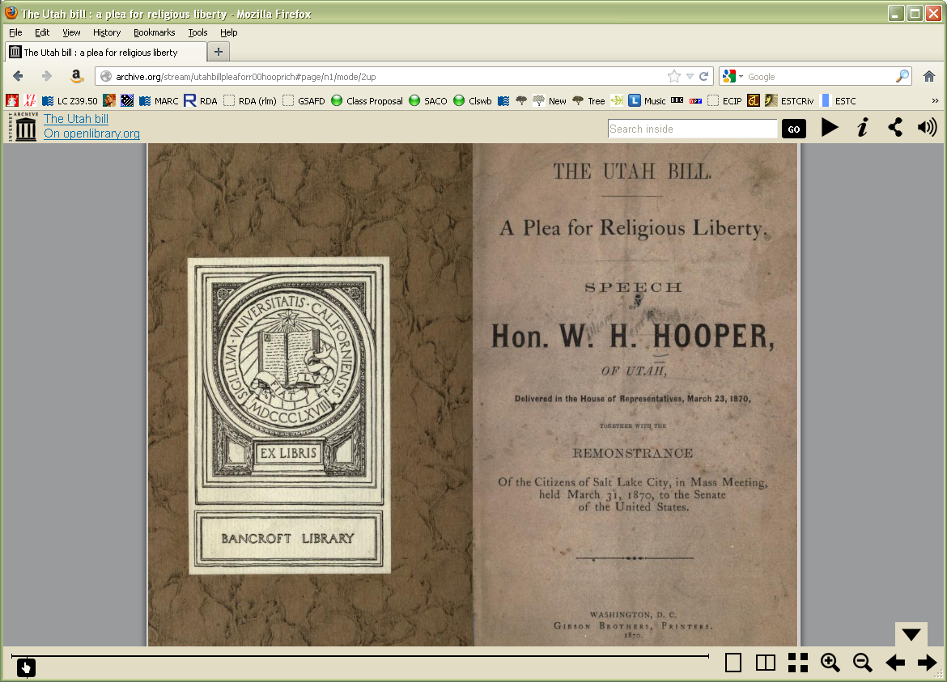
What corporate bodies
are named on this
title page?
Notes:
Utah
House of Representatives
Gibson Brothers
POINT: the Citizens of Salt Lake City are NOT a corporate body. Why not? They are a group, that has acted, but they are not identified by a particular name.

Slide 6
Identifying Corporate Bodies:
Core Elements (0.6.7)
Preferred name for the corporate body
Location of conference, etc.
Date of conference, etc.
Associated institution (core in certain cases)
Number of conference, etc.
Other designation (if CB’s name does not convey the idea of a corporate body)
Identifier
Notes:
Open to RDA 0.6.7, looking for core elements for the corporate body. CLICK THROUGH as people find them.
Remember “core” does not necessarily mean the information has to become part of the authorized access point. It simply means it must be recorded as part of the description.

Slide 7
Identifying Corporate Bodies:
Core if needed to distinguish (0.6.7)
Other place associated with the corporate body
Date of establishment
Date of termination
Period of activity of the corporate body
Associated institution
Other designation associated with the corporate body
Notes:
Open to RDA 0.6.7, looking for core elements for the corporate body. CLICK THROUGH as people find them.

Slide 8
Identifying Corporate Bodies: Transcription and Capitalization
8.5.2. Capitalization: follow Appendix A.2
8.5.4. Diacritical marks: record them as they appear; add them if it is certain that they are integral to the name but were omitted in the source
8.5.5. Retain hyphens if used by the body
8.5.6. Instructions about spacing between initials
8.5.7. Abbreviations. Follow the usage of the body
8.4. Language and script. NACO policy = Romanize vernacular scripts.
Notes:
Go to 8.5.1; have someone read, especially 8.5.6.2. Then go to Appendix A.2 & B.2 and examine together.

Slide 9
RDA 8.12. Source Consulted
Record in 670 field, or 3XX $u/$v
Always include one 670 for the work being cataloged
Others included if needed to justify information in the description
Suggested format:
  670 $a Title proper, date: $b citation (data)
Notes:
Everyone go to RDA 8.12.

Slide 10
670 field examples
  670 $a A woman’s view, 1988: $b t.p. (S.L.C. Public Library)
670 $a 1998 western letterpress broadside exchange, 1998: $b cover of prospectus (Marriott Library Book Arts Program)
670 $a Wikipedia, January 23, 2011: $b (The 2002 Winter Olympics, officially known as the XIX Olympic Winter Games; held February 8-24, 2002 in and around Salt Lake City, Utah)
670 $a Guru’s Provo Restaurant study, 2001: $b title page (Guru’s) cover (Guru’s International, Inc.) page 1 (Guru’s International Inc.; Guru's)
670 $a OCLC, June 23, 2011 $b (access point: Utah State University; usage: Utah State University; Utah State)
Notes:
Explain the OCLC 670.
There are lots of ways to form these. The point is, record information justifying what you’ve included in other elements in the description.

Slide 11
Identifying Corporate Bodies: Sources
Where can we get information about corporate bodies?
  11.1.1: Take the name or names of the corporate body from any source; take information on other identifying attributes from any source.
Notes:
Now please turn to Chapter 11 if you’re not already there.

Slide 12
Identifying Corporate bodies: Sources
Sources to check
  The resource you are cataloging
  The LC/NACO Authority File (authorities.loc.gov)
  Your database (e.g. OCLC)
  Optional: Other useful sources
    Website of corporate body being authorized
    Virtual International Authority File (http://viaf.org)
    Wikipedia (http://www.wikipedia.org/)
    Other sources such as encyclopedias and dictionaries

Slide 13
Attributes of Corporate Bodies: Name
Name is a core element
Preferred name
  Chosen according to 11.2.2.3: “Choose the name by which the corporate body is commonly identified.”
  11.2.2.2 gives help in deciding the commonly known form: prefer forms found in resources associated with the corporate body.
Notes:
Please go to 11.2. This is basically the same as AACR2 EXCEPT subtle but important difference--resources associated with rather than issued by the body. The basic principle is (11.2.2.3), we choose the name by which a corporate body is commonly identified. But look at 11.2.2.2. We are to prefer forms found in resources associated with the corporate body. What kind of resources might this include? (Publications of the corporate body; signs put up by the body; labels on buildings belonging to the CB; a CB’s home page; books about the CB)

Slide 14
Attributes of Corporate Bodies: Name
11.2.2.6. If the name of a corporate body has changed (including changes from one language to another), choose the new name as the preferred name for use with resources associated with that name.
Notes:
Turn to 11.2.2.6. In other words, in cataloging theory, if a corporate body changes its name, this is considered the birth of a new CB and the end of the old one. Why is this? Because normally when a CB officially changes its name it signals a new direction. 11.2.2.6 implies that we now have two corporate bodies, so we need two CB entity records (currently authority records). CLICK on the LCPS. Minor changes don’t count.

Slide 15
Attributes of Corporate Bodies: Recording the Name
11.2.2.4. Record the name of a corporate body as it appears in resources associated with the body.
In other words, no manipulation of the preferred name, as we do with personal names.

Slide 16
Attributes of Corporate Bodies: Recording the Name
Include full stops or not in names consisting of initials following the usage of the body (11.2.2.7)
  IBM Australia not I.B.M. Australia
Omit initial articles (11.2.2.8 alternative)
  First Church of Christ, Scientist not The First Church of Christ, Scientist
Omit terms indicating incorporation unless integral to the name or needed to make clear that it’s a corporate body (11.2.2.10)
  EBSCO Industries not EBSCO Industries, Inc.
  but Time, inc.

Slide 17
Attributes of Corporate body: Preferred Name (MARC)
Most RDA entity attributes have a discrete place in MARC to record them. Preferred name does not. It can only be recorded as part of the authorized access point for the corporate body.
Record in the MARC authorities format 110 field, first indicator 1 (if the body is a jurisdiction) or 2 (if not)
Meetings, events, expeditions are coded in X11, first indicator 2.
Record the preferred name in subfield $a. Subfield $b may also record part of the preferred name, if appropriate.
Notes:
LOOK AT MARC authority format 110 field.

Slide 18
Attributes of Corporate Body: Preferred Name (MARC examples)
The preferred name is bolded in each example
    110 1 $a United States. $b Armed Forces Bicentennial Band
    110 1 $a Utah. $b Department of Administrative Services
    110 2 $a Fifth Church of Christ (Gloucester, Mass.)
    110 2 $a Sandy Coast (Musical group)
    110 2 $a Kanab Creek Ranchos, Inc.
    110 2 $a Guru’s (Restaurant : Provo, Utah)
    110 2 $a Bountiful Junior High School
    110 1 $a Orem (Utah). $b Planning & Zoning Department
Notes:
LOOK AT MARC authority format 110 field.
Only the bolded words are the preferred name. All other pieces of this field are other elements. Comment on each one.

Slide 19
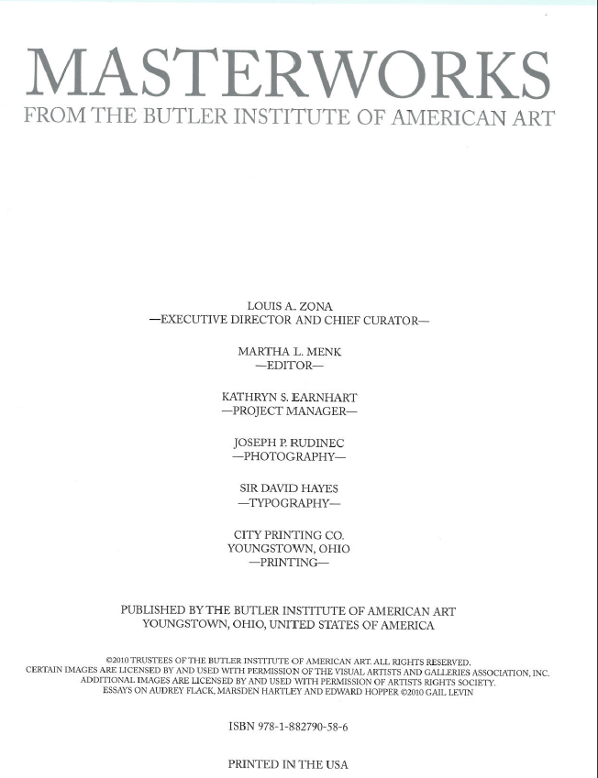
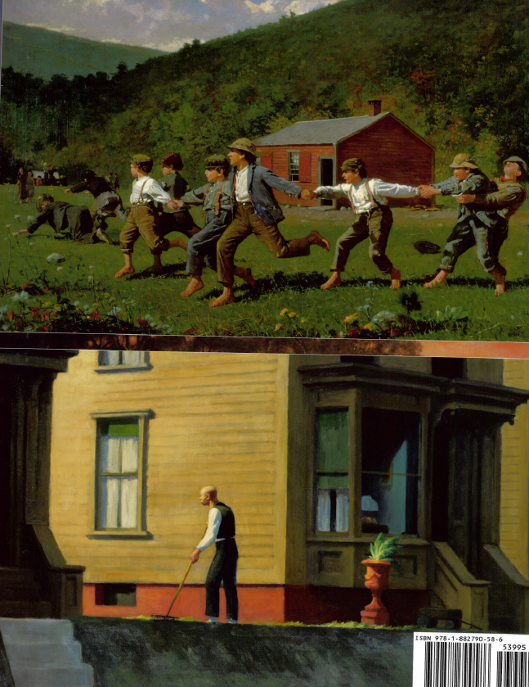
Notes:
Title page and back cover. Begin creating 670 fields on an authority worksheet.

Slide 20
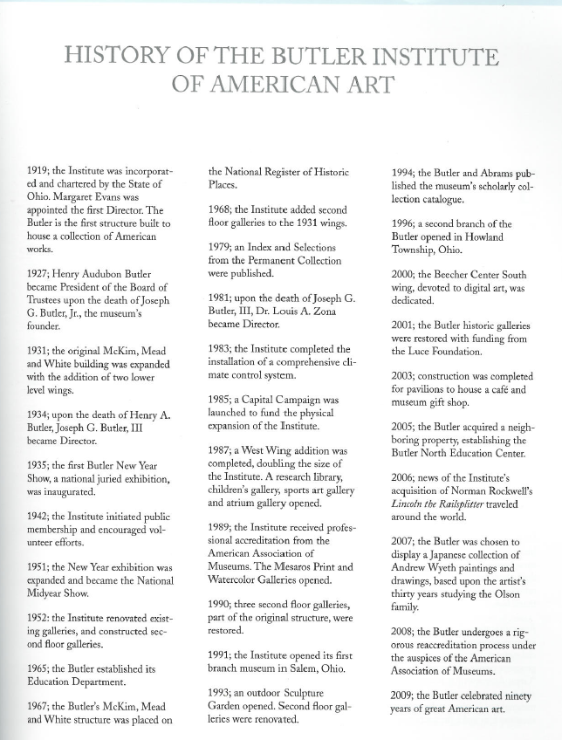
Page 9
Notes:
What attributes of the corporate body do we find on this page?

Slide 21
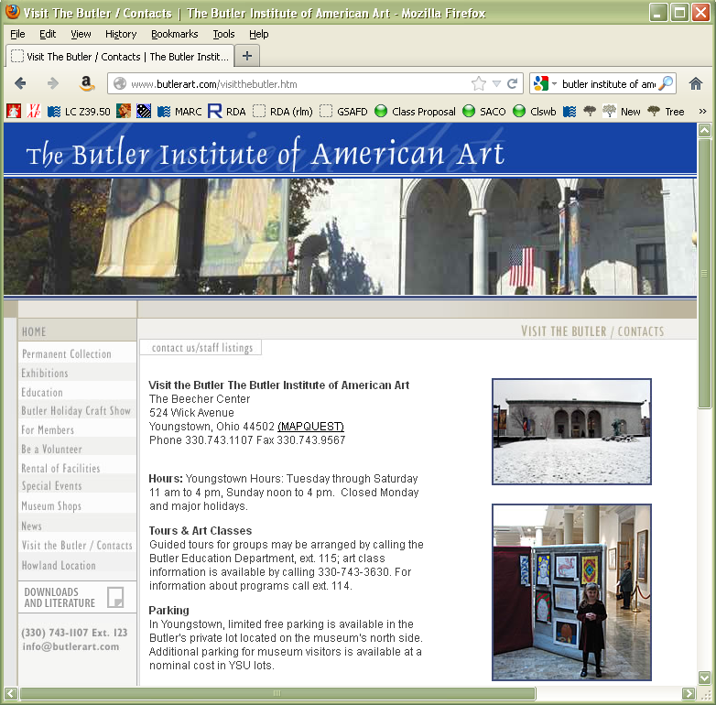
Notes:
Other attributes? (address)

Slide 22
Sources Consulted (Butler)
670 $a Masterworks from the Butler Institute of American Art, 2010: $b title page (Butler Institute of American Art, Youngstown, Ohio) page 9 (founded by Joseph G. Butler, Jr., in 1919; first director: Margaret Evans; “The Butler” was the first structure built to house a collection of American works)
670 $a The Butler Institute of American Art, via WWW, 19 October 2012 $b (address: The Beecher Center, 524 Wick Avenue, Yongstown, Ohio 44052, phone: (330)743-1107)

Slide 23
Attributes of Corporate Bodies:
Preferred Name
Record the preferred name of this body on an authority worksheet.

Slide 24
Preferred Name (Butler)
110 2 $a Butler Institute of American Art
670 $a Masterworks from the Butler Institute of American Art, 2010: $b title page (Butler Institute of American Art, Youngstown, Ohio) page 9 (founded by Joseph G. Butler, Jr., in 1919; first director: Margaret Evans; “The Butler” was the first structure built to house a collection of American works)
670 $a The Butler Institute of American Art, via WWW, 19 October 2012 $b (address: The Beecher Center, 524 Wick Avenue, Yongstown, Ohio 44052, phone: (330)743-1107)

Slide 25
Attributes of Corporate Bodies: Subordinate Bodies: Name
Basic rule the same as for non-subordinate bodies (11.2.2.13)
  Record the name as it appears unless the name belongs to one of the categories listed in 11.2.2.14
  Note 11.2.2.14.6 applies only to non-government bodies. All the rest apply to any kind of corporate body.
Notes:
READ 11.2.2.13; then look at the list of types under 11.2.2.14.

Slide 26
Exercise: CB recorded subordinately or not?
Library of Congress
  110 2 $a Library of Congress
Student Society for Ancient Studies [at Brigham Young University]
  110 2 $a Student Society for Ancient Studies
Advanced Plans Directorate [at Aerospace Corporation]
  110 2 $a Aerospace Corporation. $b Advanced Plans Directorate [11.2.2.14.1]
Corporate Grants [at Apple Computer, Inc.]
  110 2 $a Apple Computer, Inc. $b Corporate Grants [11.2.2.14.4]
Notes:
Look at LC-PCC PS under Type 2 for list of words (Directorate is found there).

Slide 27
Exercise: CB recorded subordinately or not?
The Gallery [at Scarborough College]
  110 2 $a Scarborough College. $b Gallery [11.2.2.14.3]
Centre for Medieval Studies [at University of Toronto]
  110 2 $a University of Toronto. $b Centre for Medieval Studies [11.2.2.14.5]
Scripps College Press
  110 2 $a Scripps College. $b Press [11.2.2.14.6]
U.S. Department of Defense
  110 1 $a United States. $b Department of Defense [11.2.2.14.1]

Slide 28
Exercise: CB recorded subordinately or not?
Salt Lake City Planning Commission
  110 2 $a Salt Lake City Planning Commission
  [Not 11.2.2.14.2 because not necessary to add the name of the higher body to identify the subordinate]
Sandy City Council
  110 1 $a Sandy (Utah). $b City Council [11.2.2.14.9]
Canadian Embassy/Ambassade du Canada, Washington, DC
  110 1 $a Canada. $b Embassy (U.S.) [11.2.2.14.13]

Slide 29
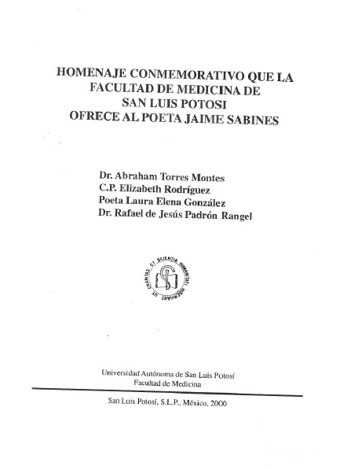
Notes:
A title page from a resource associated with the Facultad de Medicina of Universidad Autónoma de San Luis Potosí. Is this a government body? No. (In case there is question, see 11.2.2.18 exception.) How does the name appear? “Facultad de Medicina” and “Facultad de Medicina de San Luis Potosí.” Is this a subordinate body? Yes. Should we enter it under its own name or subordinately? Go through the types in 11.2.2.14. This is type 5. (Note: we won’t go through all the types as we would in a NACO workshop; this is just to show you that there is no change yet from AACR2.) Record a 670.

Slide 30
Source Consulted
(Facultad de Medicina)
670 $a Homenaje conmemorativo que la Facultad de Medicina de San Luis Potosí ofrece al poeta Jaime Sabines, 2000: $b title page (Universidad Autónoma de San Luis Potosí, Facultad de Medicina)

Slide 31
Attributes of Corporate Bodies: Subordinate Bodies: Name
11.2.2.14. Record the name of a subordinate or related body as a subdivision of the authorized access point representing the body to which it is subordinate or related if its name belongs to one or more of the types listed below.
  Universidad Autónoma de San Luis Potosí. Facultad de Medicina
Notes:
NOTE: The NACO policy still applies: we are required to establish all levels in the hierarchy. So if the University hadn’t yet been established, it would have to be established before the Facultad de Medicina can be established. LOOK UP to make sure it’s been established. RECORD THIS in a 110 field in a new worksheet (Facultad de Medicina in $b). Also there is a variant, “Facultad de Medicina de San Luis Potosí.” Record that as is in a 410.

Slide 32
Preferred Name
(Facultad de Medicina)
110 2 $a Universidad Autónoma de San Luis Potosí. $b Facultad de Medicina
670 $a Homenaje conmemorativo que la Facultad de Medicina de San Luis Potosí ofrece al poeta Jaime Sabines, 2000: $b title page (Universidad Autónoma de San Luis Potosí, Facultad de Medicina)

Slide 33
Attributes of Corporate Bodies: Name (Meetings)
11.2.2.11. Omit from the name of a conference, etc., indications of its number, or year or years of convocation, etc. …
Compare AACR2
24.7A1. Omit from the name of a conference, etc. …, indications of its number, frequency, or year(s) of convocation.
Notes:
What is missing from the RDA list? Frequency.
Note: “conference, etc.” includes congresses, meetings, exhibitions, fairs, festivals, etc.

Slide 34
Exercise: What is the preferred name of these meetings?
182nd Annual General Conference of the Church of Jesus Christ of Latter-day Saints, March 31-April 1, 2012
  110 2 $a Church of Jesus Christ of Latter-day Saints. $b Annual General Conference
Seventh Annual Global Conference on Pharmaceutical Microbiology, October 22-23 2012 (held in Bethesda, Md.)
  111 2 $a Annual Global Conference on Pharmaceutical Microbiology
The 13th International Symposium on Online Journalism (held at the Blanton Museum of Art)
  111 2 $a International Symposium on Online Journalism
Notes:
The first example is type 6, contains the entire name of the higher body.

Slide 35
Attributes of Corporate Bodies: Name (Meetings)
MARC:
Code meeting names in 111 $a unless they are established subordinately to another body. In that case, use 110; the authorized access point of the higher body is given in subfield $a and the preferred name of the meeting is given in subfield $b.

Slide 36
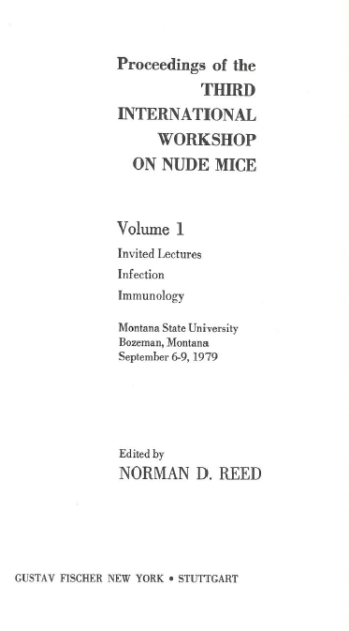
Title page
Published 1982
Notes:
Create a 670 and record the preferred name of this meeting in a worksheet.

Slide 37
Source Consulted (Nude Mice)
670 $a Proceedings of the Third International Workshop on Nude Mice, 1982: $b title page (held at Montana State University, Bozeman, Montana, September 6-9, 1979)
Notes:
Now add the preferred name

Slide 38
Preferred Name (Nude Mice)
111 2 $a International Workshop on Nude Mice
670 $a Proceedings of the Third International Workshop on Nude Mice, 1982: $b title page (held at Montana State University, Bozeman, Montana, September 6-9, 1979)

Slide 39
Attributes of Corporate Bodies:
Variant name (MARC)
Like the Preferred Name element, the Variant Name element (RDA 11.2.3) does not have a discrete place in MARC. It can only be recorded as part of the variant access point for the corporate body.
Record in the MARC authorities format 410 field, first indicator 1 (if the body is a jurisdiction) or 2 (if not)
Record the variant name in subfield $a. Subfield $b may also record part of the variant name, if appropriate.

Slide 40
Notes:
Do you see a variant name here? The Butler. Record this in a 410 field on the appropriate worksheet.

Slide 41
Variant Name (Butler)
110 2 $a Butler Institute of American Art
410 2 $a Butler
670 $a Masterworks from the Butler Institute of American Art, 2010: $b title page (Butler Institute of American Art, Youngstown, Ohio) page 9 (founded by Joseph G. Butler, Jr., in 1919; first director: Margaret Evans; “The Butler” was the first structure built to house a collection of American works)
670 $a The Butler Institute of American Art, via WWW, 19 October 2012 $b (address: The Beecher Center, 524 Wick Avenue, Yongstown, Ohio 44052, phone: (330)743-1107)
Notes:
Don’t worry, we’re not done with this 410– more later.

Slide 42
Notes:
There was also a variant for this body -- ?

Slide 43
Variant Name
(Facultad de Medicina)
110 2 $a Universidad Autónoma de San Luis Potosí. $b Facultad de Medicina
410 2 $a Facultad de Medicina de San Luis Potosí
670 $a Homenaje conmemorativo que la Facultad de Medicina de San Luis Potosí ofrece al poeta Jaime Sabines, 2000: $b title page (Universidad Autónoma de San Luis Potosí, Facultad de Medicina)

Slide 44
Attributes of Corporate Bodies: Place
RDA 11.3. Place is a core element for conferences; for other types of corporate bodies, it is not core, but it may be recorded.
The element is recorded in MARC 370 field
May be included in the access point if needed to distinguish

Slide 45
Recording the Place Attribute
Place is recorded in MARC 370
  Associated country $c
  Place of headquarters $e
  Other associated place $f
Notes:
LOOK AT MARC

Slide 46
Recording the Place Attribute
The form of the place name is governed by RDA Chapter 16.
Authorized access points for jurisdictional place names are generally formed as in AACR2, e.g. “Paris (France)”
LC/PCC Practice: record in 370 exactly as established in the Authority File
If the place has been established in the Authority File, include $2 naf at the end of the field.

Slide 47
Recording the Place Attribute
370 $e London (England) $2 naf [place of headquarters]
370 $f Mexico City (Mexico) $2 naf [other associated place]
370 $e Austin (Tex.) $2 naf [place of headquarters]
370 $f Ontario (Calif.) $2 naf [other associated place]
370 $e Arizona $2 naf [place of headquarters]
370 $e District of Columbia $2 naf [place of headquarters]
370 $c United States $2 naf [associated country]
370 $e Auckland (N.Z.) $f Puerto Rico $c France $2 naf
[place of headquarters, other associated place, associated country]
Notes:
Remember for the moment we are required to use forms as established using the English rules. Note that 370 can be repeated, or alternately subfields can be repeated within a single 370.

Slide 48
Recording the Place Attribute
  Headquarters of the Universidad Autónoma de San Luis Potosí and the Facultad de Medicina is San Luis Potosí
  This place is established as San Luis Potosí (Mexico)
  This element is recorded in MARC
    370 $e San Luis Potosí (Mexico) $2 naf
Notes:
RECORD the place element in the appropriate worksheet

Slide 49
Place
(Facultad de Medicina)
110 2 $a Universidad Autónoma de San Luis Potosí. $b Facultad de Medicina
370 $e San Luis Potosí (Mexico) $2 naf
410 2 $a Facultad de Medicina de San Luis Potosí
670 $a Homenaje conmemorativo que la Facultad de Medicina de San Luis Potosí ofrece al poeta Jaime Sabines, 2000: $b title page (Universidad Autónoma de San Luis Potosí, Facultad de Medicina)

Slide 50
Notes:
Record the place attribute for the Butler Institute of American Art in its worksheet (in 370 only for now)

Slide 51
Place (Butler)
110 2 $a Butler Institute of American Art
370 $e Youngstown (Ohio) $2 naf
410 2 $a Butler
670 $a Masterworks from the Butler Institute of American Art, 2010: $b title page (Butler Institute of American Art, Youngstown, Ohio) page 9 (founded by Joseph G. Butler, Jr., in 1919; first director: Margaret Evans; “The Butler” was the first structure built to house a collection of American works)
670 $a The Butler Institute of American Art, via WWW, 19 October 2012 $b (address: The Beecher Center, 524 Wick Avenue, Yongstown, Ohio 44052, phone: (330)743-1107)
Notes:
Don’t worry, we’re not done with this 410– more later.

Slide 52
Notes:
Record the place attribute for the Workshop in its worksheet (in 370 only for now)

Slide 53
Place (Nude Mice)
111 2 $a International Workshop on Nude Mice
370 $e Bozeman (Mont.) $2 naf
670 $a Proceedings of the Third International Workshop on Nude Mice, 1982: $b title page (held at Montana State University, Bozeman, Montana, September 6-9, 1979)

Slide 54
Attributes of Corporate Bodies: Dates
Several types of date
  Date of a conference, etc. (11.4.2)
  Date of establishment (11.4.3)
  Date of termination (11.4.4)
  Period of activity (11.4.5)
The date of conference element is core. If it is known it should be recorded as an element.
  This does not necessarily mean it will be recorded as part of the access point
Other known dates may also be recorded
Notes:
Go to 11.4. Read together.
NOTE: PCC has not yet implemented the period of activity element.

Slide 55
Attributes of Corporate Bodies: Dates
Basic instructions:
  Known date: 2005
  Probable date: 1957?
  One of two years: 1675 or 1676
  Approximate date: approximately 1953
  Ranges of dates may also be recorded

Slide 56
Attributes of Corporate Bodies: Dates
Except for century dates, this element is recorded in MARC 046 in the format YYYY-MM-DD or YYYY-MM or YYYY (using the EDTF format, with $2 edtf).
EDTF format: http://www.loc.gov/standards/datetime/. See this website for more complex situations.
Century dates do not follow the EDTF format. Simply record the first two digits of the century (e.g. “19” = all dates beginning with “19” = 20th century) with no $2.
MARC
  $q – Date of establishment* $s – Start of period of activity
  $r – Date of termination* $t – End of period of activity
Notes:
GO TO MARC 046 field
* NOTE: PCC has not yet implemented $q and $r. DO NOT USE until implementation. Until then, $s and $t stand for date of establishment and date of termination.
Record the date element in 046 for the Workshop and for the Museum (next slides)

Slide 57
Attributes of Corporate Bodies: Dates
For a company founded in 1960
046 $q 1960 $2 edtf *
For a musical group that started in 1960 and broke up in 1970
046 $q 1960 $r 1970 $2 edtf *
Date of establishment: $q
Date of termination: $r
Module 6. Describing Corporate Bodies
57
Notes:
November 25, 2015
* NOTE: PCC has not yet implemented $q and $r. DO NOT USE until implementation. Until then, $s and $t stand for date of establishment and date of termination.

Slide 58
Attributes of Corporate Bodies: Dates
Expressing unusual dates in EDTF *
  1902? = 046 $q 1902? $2 edtf
  Approximately 1902 = 046 $q 1902~ $2 edtf
  Either 1901 and 1902 = 046 $q [1901,1902] $2 edtf
  Between 1950 and 1955 = 046 $q [1950..1955] $2 edtf
  BC dates begin with a negative sign, and are one year off (because there was no year 0)
    147 B.C. = 046 $q -0146 $2 edtf
  See https://www.loc.gov/standards/datetime/ for other situations
Module 6. Describing Corporate Bodies
58
Notes:
November 25, 2015
BC dates are one year off because there was no year “0”.
* NOTE: PCC has not yet implemented $q and $r. DO NOT USE until implementation. Until then, $s and $t stand for date of establishment and date of termination.

Slide 60
Date (Nude Mice)
046 $q 1979-09-06 $r 1979-09-09 $2 edtf *
111 2 $a International Workshop on Nude Mice
370 $e Bozeman (Mont.) $2 naf
670 $a Proceedings of the Third International Workshop on Nude Mice, 1982: $b title page (held at Montana State University, Bozeman, Montana, September 6-9, 1979)
Notes:
* NOTE: PCC has not yet implemented $q and $r. DO NOT USE until implementation. Until then, $s and $t stand for date of establishment and date of termination.

Slide 62
Date (Butler)
046 $q 1919 $2 edtf
110 2 $a Butler Institute of American Art
370 $e Youngstown (Ohio) $2 naf
410 2 $a Butler
670 $a Masterworks from the Butler Institute of American Art, 2010: $b title page (Butler Institute of American Art, Youngstown, Ohio) page 9 (founded by Joseph G. Butler, Jr., in 1919; first director: Margaret Evans; “The Butler” was the first structure built to house a collection of American works)
670 $a The Butler Institute of American Art, via WWW, 19 October 2012 $b (address: The Beecher Center, 524 Wick Avenue, Yongstown, Ohio 44052, phone: (330)743-1107)
Notes:
Don’t worry, we’re not done with this 410– more later.
* NOTE: PCC has not yet implemented $q and $r. DO NOT USE until implementation. Until then, $s and $t stand for date of establishment and date of termination.

Slide 63
Attributes of Corporate Bodies: Associated Institution
11.5. Associated institution is core only for some conferences, but may be recorded for any corporate body
Record the preferred name of the associated institution (use the authorized form from NAF)
Associated Institution is recorded in MARC 373
If found in NAF, include $2 naf at the end of 373
Notes:
Look together at 11.5.
Use the preferred name (as of July 2013). Not required to establish, but if it is established, use the authorized form, and include $2 naf in the field.

Slide 64
Notes:
Record the associated institution for the Workshop on the appropriate worksheet.

Slide 65
Associated Institution (Nude Mice)
046 $q 1979-09-06 $r 1979-09-09 $2 edtf
111 2 $a International Workshop on Nude Mice
370 $e Bozeman (Mont.) $2 naf
373 $a Montana State University (Bozeman, Mont.) $2 naf
670 $a Proceedings of the Third International Workshop on Nude Mice, 1982: $b title page (held at Montana State University, Bozeman, Montana, September 6-9, 1979)
Notes:
* NOTE: PCC has not yet implemented $q and $r. DO NOT USE until implementation. Until then, $s and $t stand for date of establishment and date of termination.

Slide 66
Attributes of Corporate Bodies: Number of a conference, etc.
11.6. A number of a conference is core.
There is no discrete place in MARC to record this element; it must be recorded as part of an access point
Record as an ordinal numeral
MARC X11 or X10 $n; numeral recorded following an opening parenthesis
    ... $n (66th ...

Slide 67
Notes:
Record the number of the conference on the appropriate worksheet.

Slide 68
Number of a Conference, etc.
(Nude Mice)
046 $q 1979-09-06 $r 1979-09-09 $2 edtf
111 2 $a International Workshop on Nude Mice $n (3rd
370 $e Bozeman (Mont.) $2 naf
373 $a Montana State University (Bozeman, Mont.) $2 naf
670 $a Proceedings of the Third International Workshop on Nude Mice, 1982: $b title page (held at Montana State University, Bozeman, Montana, September 6-9, 1979)

Slide 69
Attributes of Corporate Bodies: Other Designation
11.7. This element is core if the name does not convey the idea of a corporate body or if needed to distinguish between two corporate bodies with the same name. It can also be recorded for other corporate bodies.
Can use any term that describes or clarifies the nature of the corporate body, such as “Library” “Papermaker” “Meeting”
Record this element in a MARC authorities 368 field, subfields $a or (sometimes) $c.
PCC practice prefers controlled forms. If a controlled form is recorded, include source in $2 (e.g. $2 lcsh)
Notes:
Go to 11.7.

Slide 70
Attributes of Corporate Bodies: Other Designation
110 2 $a Apollo 11 (Spacecraft)
368 $a Space vehicles $2 lcsh
110 2 $a Red Hot Chili Peppers (Musical group)
368 $a Musical groups $2 lcsh
110 2 $a Hill Monastic Manuscript Library
368 $a Libraries $2 lcsh
110 2 $a Wookey Hole Mill
368 $a Papermakers $2 lcsh
Notes:
NOTE: You might say, “well, that’s obvious” for the Library, but remember it’s not obvious for a machine and this element might be used to bring together all libraries, including those without the word “Library” in the name (e.g. Biblioteca)
EXERCISE: Add this element to the three descriptions you’re working on.
Possibilities (find controlled form in LCSH):
For the workshop: “Workshop” “Conference” “Meeting”, etc.
For the Butler Institute: “Museum”, etc.
For the UASLP faculty, “Medical school” etc.

Slide 71
Other Designation (Butler)
046 $q 1919 $2 edtf
110 2 $a Butler Institute of American Art
368 $a Museums $2 lcsh
370 $e Youngstown (Ohio) $2 naf
410 2 $a Butler
670 $a Masterworks from the Butler Institute of American Art, 2010: $b title page (Butler Institute of American Art, Youngstown, Ohio) page 9 (founded by Joseph G. Butler, Jr., in 1919; first director: Margaret Evans; “The Butler” was the first structure built to house a collection of American works)
670 $a The Butler Institute of American Art, via WWW, 19 October 2012 $b (address: The Beecher Center, 524 Wick Avenue, Yongstown, Ohio 44052, phone: (330)743-1107)
Notes:
Don’t worry, we’re not done with this 410– more later.

Slide 72
Other Designation
(Facultad de Medicina)
110 2 $a Universidad Autónoma de San Luis Potosí. $b Facultad de Medicina
368 $a Medical colleges $2 lcsh
370 $e San Luis Potosí (Mexico) $2 naf
410 2 $a Facultad de Medicina de San Luis Potosí
670 $a Homenaje conmemorativo que la Facultad de Medicina de San Luis Potosí ofrece al poeta Jaime Sabines, 2000: $b title page (Universidad Autónoma de San Luis Potosí, Facultad de Medicina)

Slide 73
Other Designation (Nude Mice)
046 $q 1979-09-06 $r 1979-09-09 $2 edtf
111 2 $a International Workshop on Nude Mice $n (3rd
368 $a Congresses and conventions $2 lcsh
370 $e Bozeman (Mont.) $2 naf
373 $a Montana State University (Bozeman, Mont.) $2 naf
670 $a Proceedings of the Third International Workshop on Nude Mice, 1982: $b title page (held at Montana State University, Bozeman, Montana, September 6-9, 1979)

Slide 74
Attributes of Corporate Bodies:
Language
11.8. Language of the corporate body is a language a corporate body uses in its communications.
Recorded in MARC 377, using the MARC language code
377 $a spa
377 $a eng
Notes:
Look at 11.8 together.
Add language element to all the worksheets.

Slide 75
Language (Butler)
046 $q 1919 $2 edtf
110 2 $a Butler Institute of American Art
368 $a Museums $2 lcsh
370 $e Youngstown (Ohio) $2 naf
377 $a eng
410 2 $a Butler
670 $a Masterworks from the Butler Institute of American Art, 2010: $b title page (Butler Institute of American Art, Youngstown, Ohio) page 9 (founded by Joseph G. Butler, Jr., in 1919; first director: Margaret Evans; “The Butler” was the first structure built to house a collection of American works)
670 $a The Butler Institute of American Art, via WWW, 19 October 2012 $b (address: The Beecher Center, 524 Wick Avenue, Yongstown, Ohio 44052, phone: (330)743-1107)
Notes:
Don’t worry, we’re not done with this 410– more later.

Slide 76
Language
(Facultad de Medicina)
110 2 $a Universidad Autónoma de San Luis Potosí. $b Facultad de Medicina
368 $a Medical colleges $2 lcsh
370 $e San Luis Potosí (Mexico) $2 naf
$a spa
410 2 $a Facultad de Medicina de San Luis Potosí
670 $a Homenaje conmemorativo que la Facultad de Medicina de San Luis Potosí ofrece al poeta Jaime Sabines, 2000: $b title page (Universidad Autónoma de San Luis Potosí, Facultad de Medicina)

Slide 77
Language (Nude Mice)
046 $q 1979-09-06 $r 1979-09-09 $2 edtf
111 2 $a International Workshop on Nude Mice $n (3rd
368 $a Workshops $2 lcsh
370 $e Bozeman (Mont.) $2 naf
373 $a Montana State University (Bozeman, Mont.) $2 naf
377 $a eng
670 $a Proceedings of the Third International Workshop on Nude Mice, 1982: $b title page (held at Montana State University, Bozeman, Montana, September 6-9, 1979)

Slide 78
Attributes of Corporate Bodies:
Address
11.9. Street address of the corporate body’s headquarters; or e-mail or Internet address
Recorded in MARC 371
  $a Street address
  $b City
  $c Intermediate jurisdiction (e.g. State)
  $d Country
  $e Postal Code
  $m Electronic mail address
  $s Start period
  $t End period
Notes:
Look at 11.9 together.

Slide 79
Notes:
Record the Address element for the Butler Institute.

Slide 80
Address (Butler)
046 $q 1919 $2 edtf
110 2 $a Butler Institute of American Art
368 $a Museums $2 lcsh
370 $e Youngstown (Ohio) $2 naf
371 $a The Beecher Center $a 524 Wick Avenue $b Youngstown $c Ohio $e 44052 $m info@butlerart.com $v Institute website $u www.butlerart.com
377 $a eng
410 2 $a Butler
670 $a Masterworks from the Butler Institute of American Art, 2010: $b title page (Butler Institute of American Art, Youngstown, Ohio) page 9 (founded by Joseph G. Butler, Jr., in 1919; first director: Margaret Evans; “The Butler” was the first structure built to house a collection of American works)
670 $a The Butler Institute of American Art, via WWW, 19 October 2012 $b (address: The Beecher Center, 524 Wick Avenue, Yongstown, Ohio 44052, phone: (330)743-1107)
Notes:
Don’t worry, we’re not done with this 410– more later.

Slide 81
Attributes of Corporate Bodies:
Field of Activity
11.10. This element is not core.
Can use any term or phrase to describe what the body does
Record in MARC authorities format 372 field
PCC practice prefers controlled vocabulary
If you record a controlled term, record the source in $2 (e.g. $2 lcsh)
Notes:
Look at 11.10 together.

Slide 82
Attributes of Corporate Bodies: Field of Activity
110 2 $a Apollo 11 (Spacecraft)
372 $a Outer space--Exploration $2 lcsh
110 1 $a Sandy (Utah). $b City Council
372 $a Municipal government $2 lcsh
110 2 $a Hill Monastic Manuscript Library
372 $a Manuscript collection $a Manuscript preservation
110 2 $a Wookey Hole Mill
372 $a Papermaking $2 lcsh
Notes:
EXERCISE: Add this element to the three descriptions you’re working on.
Possibilities:
For the workshop: “Nude mice”
For the Butler Institute: “Art”
For the UASLP faculty, “Medicine”

Slide 83
Field of Activity (Butler)
046 $q 1919 $2 edtf
110 2 $a Butler Institute of American Art
368 $a Museums $2 lcsh
370 $e Youngstown (Ohio) $2 naf
371 $a The Beecher Center $a 524 Wick Avenue $b Youngstown $c Ohio $e 44052 $m info@butlerart.com $v Institute website $u www.butlerart.com
372 $a Art, American $2 lcsh
377 $a eng
410 2 $a Butler
670 $a Masterworks from the Butler Institute of American Art, 2010: $b title page (Butler Institute of American Art, Youngstown, Ohio) page 9 (founded by Joseph G. Butler, Jr., in 1919; first director: Margaret Evans; “The Butler” was the first structure built to house a collection of American works)
670 $a The Butler Institute of American Art, via WWW, 19 October 2012 $b (address: The Beecher Center, 524 Wick Avenue, Yongstown, Ohio 44052, phone: (330)743-1107)

Slide 84
Field of Activity
(Facultad de Medicina)
110 2 $a Universidad Autónoma de San Luis Potosí. $b Facultad de Medicina
368 $a Medical colleges $2 lcsh
370 $e San Luis Potosí (Mexico) $2 naf
372 $a Medicine $2 lcsh
377 $a spa
410 2 $a Facultad de Medicina de San Luis Potosí
670 $a Homenaje conmemorativo que la Facultad de Medicina de San Luis Potosí ofrece al poeta Jaime Sabines, 2000: $b title page (Universidad Autónoma de San Luis Potosí, Facultad de Medicina)

Slide 85
Field of Activity (Nude Mice)
046 $q 1979-09-06 $r 1979-09-09 $2 edtf
111 2 $a International Workshop on Nude Mice $n (3rd
368 $a Workshops $2 lcsh
370 $e Bozeman (Mont.) $2 naf
$a Nude mouse $2 lcsh
373 $a Montana State University (Bozeman, Mont.) $2 naf
377 $a eng
670 $a Proceedings of the Third International Workshop on Nude Mice, 1982: $b title page (held at Montana State University, Bozeman, Montana, September 6-9, 1979)

Slide 86
Attributes of Corporate Bodies:
Corporate History
11.11. Information pertaining to the history and nature of the body. This element is not core.
Record a brief statement about the body. This is entirely free text, in your own words, based on the sources you have consulted.
Intended to be read by the public.
Notes:
Look at 11.11 together.

Slide 87
Attributes of Corporate Bodies:
Corporate History
Record this element in a MARC authority 678 field, first indicator “1”.
    678 1 $a Paramount Pictures Corporation is a motion picture production and distribution company. It was established in 1949 after a court-ordered split of Paramount Pictures, Inc.
    678 1 $a Wookey Hole Mill is a papermaker in Somerset, England. It has been in operation since the early 1600s.
Notes:
EXERCISE: Record the corporate history element for the Butler Institute (see following slide)

Slide 88
Notes:
Write a brief corporate history for the Butler Institute of American Art.

Slide 89
Corporate History (Butler)
046 $q 1919 $2 edtf
110 2 $a Butler Institute of American Art
368 $a Museums $2 lcsh
370 $e Youngstown (Ohio) $2 naf
371 $a The Beecher Center $a 524 Wick Avenue $b Youngstown $c Ohio $e 44052 $m info@butlerart.com $v Institute website $u www.butlerart.com
372 $a Art, American $2 lcsh
377 $a eng
410 2 $a Butler
670 $a Masterworks from the Butler Institute of American Art, 2010: $b title page (Butler Institute of American Art, Youngstown, Ohio) page 9 (founded by Joseph G. Butler, Jr., in 1919; first director: Margaret Evans; “The Butler” was the first structure built to house a collection of American works)
$a The Butler Institute of American Art, via WWW, 19 October 2012 $b (address: The Beecher Center, 524 Wick Avenue, Yongstown, Ohio 44052, phone: (330)743-1107)
678 1 $a The Butler Institute of American Art, founded by Joseph G. Butler, Jr., in 1919 in Youngstown, Ohio, was the first museum built specifically to house a collection of American works.

Slide 90
Attributes of Corporate Body:
Identifier
A character string uniquely associated with a person or an authority record
LCCN associated with an authority record is an identifier, recorded in 010
The element is core, but it is usually added to record automatically
Notes:
Look at RDA 9.18 together

Slide 91
Constructing the Authorized Access Point for a Corporate Body (RDA 11.13.1)
Authorized Access Point is constructed using elements you have already recorded in the description
Begin with the preferred name (11.13.1.1)
If the name does not convey the idea of a corporate body, add a qualifier (11.13.1.1)
Make required additions (11.13.1.2 or 11.13.1.3 in certain cases, 11.13.1.8)
Notes:
Read 11.13 together, including all the required additions (linger on the requirement to add place to local church and radio/TV station)

Slide 92
Constructing the Authorized Access Point for a Corporate Body (RDA 11.13.1)
Make other additions if necessary to distinguish the new authorized access point from another (11.13.1.2-11.13.1.7)
Many of these can optionally be added if the addition assists in the identification of the body
  Place (11.13.1.3 option)
  Associated institution (11.13.1.4 option)
  Date (11.13.1.5 option)
  Other designation (11.13.1.6 option)
Notes:
Read 11.13 together.
What will the authorized access point be for the Butler and the Faculty of Medicine?

Slide 93
Authorized Access Point (Butler)
046 $q 1919 $2 edtf
110 2 $a Butler Institute of American Art
368 $a Museums $2 lcsh
370 $e Youngstown (Ohio) $2 naf
371 $a The Beecher Center $a 524 Wick Avenue $b Youngstown $c Ohio $e 44052 $m info@butlerart.com $v Institute website $u www.butlerart.com
372 $a Art, American $2 lcsh
377 $a eng
410 2 $a Butler
670 $a Masterworks from the Butler Institute of American Art, 2010: $b title page (Butler Institute of American Art, Youngstown, Ohio) page 9 (founded by Joseph G. Butler, Jr., in 1919; first director: Margaret Evans; “The Butler” was the first structure built to house a collection of American works)
$a The Butler Institute of American Art, via WWW, 19 October 2012 $b (address: The Beecher Center, 524 Wick Avenue, Yongstown, Ohio 44052, phone: (330)743-1107)
678 1 $a The Butler Institute of American Art, founded by Joseph G. Butler, Jr., in 1919 in Youngstown, Ohio, was the first museum built specifically to house a collection of American works

Slide 94
Authorized Access Point
(Facultad de Medicina)
110 2 $a Universidad Autónoma de San Luis Potosí. $b Facultad de Medicina
368 $a Medical colleges $2 lcsh
370 $e San Luis Potosí (Mexico) $2 naf
372 $a Medicine $2 lcsh
377 $a spa
410 2 $a Facultad de Medicina de San Luis Potosí
670 $a Homenaje conmemorativo que la Facultad de Medicina de San Luis Potosí ofrece al poeta Jaime Sabines, 2000: $b title page (Universidad Autónoma de San Luis Potosí, Facultad de Medicina)

Slide 95
Constructing the Authorized Access Point for a Corporate Body (RDA 11.13.1)
If the corporate body is a conference (etc.), add the following elements as qualifiers if applicable (11.13.1.8). Record within one set of parentheses; separate elements by space – colon – space.
  The number of the conference (see 11.6) in subfield $n
    Record as an ordinal numeral, e.g. “6th”
  The date of the conference (see 11.4.2) in subfield $d
    Record only the year unless two or more conferences with the same name were held in one year
(continued on next slide)
Notes:
Read 11.13 together.

Slide 96
Constructing the Authorized Access Point for a Corporate Body (RDA 11.13.1)
If the corporate body is a conference (etc.), add the following elements as qualifiers if applicable (11.13.1.8). Record within one set of parentheses; separate elements by space – colon – space.
  (continued from previous slide)
  The location of the conferece (see 11.3.2) in subfield $c
    Record places in the same form used in 370
    Alternately, record the name of an associated institution if that gives better identification. Use the same form used in 373.
  111 2_ $a International Congress of Papyrology $n (12th : $d 1968 : $c University of Michigan)
Notes:
Construct the authorized access point for the Workshop

Slide 97
Authorized Access Point
(Nude Mice)
046 $q 1979-09-06 $r 1979-09-09 $2 edtf
111 2 $a International Workshop on Nude Mice $n (3rd : $d 1979 : $c Montana State University (Bozeman, Mont.)) [or $c Bozeman, Mont.]
368 $a Workshops $2 lcsh
370 $e Bozeman (Mont.) $2 naf
$a Nude mouse $2 lcsh
373 $a Montana State University (Bozeman, Mont.) $2 naf
377 $a eng
670 $a Proceedings of the Third International Workshop on Nude Mice, 1982: $b title page (held at Montana State University, Bozeman, Montana, September 6-9, 1979)

Slide 98
Constructing Variant Access Points for a Corporate Body (RDA 11.13.2)
Variant access points are not core. Include them if in your judgment they would help the user find or identify the body.
  Begin with a variant name (11.2.3)
  Make further additions to the name if you consider them to be important for identification in the same way such additions would have been added to a preferred name. These additions are not required.
Notes:
Read 11.13.2 together.

Slide 99
Constructing Variant Access Points for a Corporate Body (RDA 11.13)
Finish constructing any variant access points on your worksheets for the three bodies we’ve been working on.

Slide 100
Variant Access Point (Butler)
046 $q 1919 $2 edtf
110 2 $a Butler Institute of American Art
368 $a Museums $2 lcsh
370 $e Youngstown (Ohio) $2 naf
371 $a The Beecher Center $a 524 Wick Avenue $b Youngstown $c Ohio $e 44052 $m info@butlerart.com $v Institute website $u www.butlerart.com
372 $a Art, American $2 lcsh
377 $a eng
410 2 $a Butler (Museum) [or (Institute)]
670 $a Masterworks from the Butler Institute of American Art, 2010: $b title page (Butler Institute of American Art, Youngstown, Ohio) page 9 (founded by Joseph G. Butler, Jr., in 1919; first director: Margaret Evans; “The Butler” was the first structure built to house a collection of American works)
$a The Butler Institute of American Art, via WWW, 19 October 2012 $b (address: The Beecher Center, 524 Wick Avenue, Yongstown, Ohio 44052, phone: (330)743-1107)
678 1 $a The Butler Institute of American Art, founded by Joseph G. Butler, Jr., in 1919 in Youngstown, Ohio, was the first museum built specifically to house a collection of American works
Notes:
Note we need to qualify the variant here.

Slide 101
Variant Access Point
(Facultad de Medicina)
110 2 $a Universidad Autónoma de San Luis Potosí. $b Facultad de Medicina
368 $a Medical colleges $2 lcsh
370 $e San Luis Potosí (Mexico) $2 naf
372 $a Medicine $2 lcsh
377 $a spa
410 2 $a Facultad de Medicina de San Luis Potosí
670 $a Homenaje conmemorativo que la Facultad de Medicina de San Luis Potosí ofrece al poeta Jaime Sabines, 2000: $b title page (Universidad Autónoma de San Luis Potosí, Facultad de Medicina)

Slide 102
Reminder: Source Consulted
RDA 8.12.1.3. Cite sources used to determine a preferred or variant name, followed by a brief statement of the information found. Identify the specific location within the source where the information was found.
RDA examples reflect NACO practice. Sources consulted are recorded in MARC 670 fields.
Notes:
Record the sources consulted on your worksheet (go back to the earlier slides if necessary)

Slide 103
Related Corporate Bodies (RDA 32)
Related bodies are recorded in 510 fields, and may include a relationship indicator in subfield $i (from RDA Appendix K), with $w r, or use MARC $w coding.
    110 2 $a Universidad Autónoma de San Luis Potosí. $b Facultad de Medicina
    510 2 $w r $i Hierarchical superior: $a Universidad Autónoma de San Luis Potosí
    110 2 $a Paramount Pictures Corporation (1914-1927)
    510 2 $w r $i Product of a merger: $a Paramount Famous Lasky Corporation
    OR 510 2 $w b $a Paramount Famous Lasky Corporation
Notes:
Of the bodies we’ve been working on, only the Medical School has a related body. It is possible (and permissible) to add this 510, but it hasn’t been done much yet since the hierarchical superior also appears in the authorized access point itself. More typical are earlier and later bodies.
Point out that this is MARC order; OCLC flips $w to the end.

Slide 104
Related Persons (RDA 30)
Related persons are recorded in 500 fields, and may include a relationship indicator in subfield $i (from RDA Appendix K), with $w r.
    110 2 $a Paramount Pictures Corporation (1914-1927)
    500 1 $w r $i Founder: $a Hodkinson, W. W. $q (William Wadsworth), $d 1881-1971
Notes:
There is a related person for the Butler – who? The founder.

Slide 105
Related Person (Butler)
046 $q 1919 $2 edtf
110 2 $a Butler Institute of American Art
368 $a Museums $2 lcsh
370 $e Youngstown (Ohio) $2 naf
371 $a The Beecher Center $a 524 Wick Avenue $b Youngstown $c Ohio $e 44052 $m info@butlerart.com $v Institute website $u www.butlerart.com
372 $a Art, American $2 lcsh
377 $a eng
410 2 $a Butler (Museum) [or (Institute)]
500 1 $w r $i Founder: $a Butler, Joseph G., $c Jr. $q (Joseph Green), $d 1840-1927
670 $a Masterworks from the Butler Institute of American Art, 2010: $b title page (Butler Institute of American Art, Youngstown, Ohio) page 9 (founded by Joseph G. Butler, Jr., in 1919; first director: Margaret Evans; “The Butler” was the first structure built to house a collection of American works)
$a The Butler Institute of American Art, via WWW, 19 October 2012 $b (address: The Beecher Center, 524 Wick Avenue, Yongstown, Ohio 44052, phone: (330)743-1107)
678 1 $a The Butler Institute of American Art, founded by Joseph G. Butler, Jr., in 1919 in Youngstown, Ohio, was the first museum built specifically to house a collection of American works

Slide 106
Related Families (RDA 31)
Related families are also recorded in 500 fields. You may include a relationship indicator in subfield $i (from RDA Appendix K), with $w r.
    110 2 $a Linnell Family Association
    500 3 $w r $i Founding family: $a Linnell (Family : $d 1638- : $c North America)

Slide 107
RDA authority record core and non-core
040 $a UPB $b eng $c UPB $e rda
046 $q 1919 $2 edtf
110 2 $a Butler Institute of American Art
410 2 $a Butler (Museum) [or (Institute)]
368 $a Museums $2 lcsh
370 $e Youngstown (Ohio) $2 naf
371 $a The Beecher Center $a 524 Wick Avenue $b Youngstown $c Ohio $e 44052 $m info@butlerart.com $v Institute website $u www.butlerart.com
372 $a Art, American $2 lcsh
377 $a eng
500 1 $w r $i Founder: $a Butler, Joseph G., $c Jr. $q (Joseph Green), $d 1840-1927
670 $a Masterworks from the Butler Institute of American Art, 2010: $b title page (Butler Institute of American Art, Youngstown, Ohio) page 9 (founded by Joseph G. Butler, Jr. in 1919; first director: Margaret Evans; “The Butler” was the first structure built to house a collection of American works)
670 $a The Butler Institute of American Art, via WWW, 19 October 2012 $b (address: The Beecher Center, 524 Wick Avenue, Yongstown, Ohio 44052, phone: (330)743-1107)
678 1 $a The Butler Institute of American Art, founded by Joseph G. Butler, Jr., in 1919 in Youngstown, Ohio, was the first museum built specifically to house a collection of American works.
Notes:
NOTE: talk about $v and $u in 371; and about $2 in 372

Slide 108
RDA authority record core and non-core
040 $a UPB $b eng $erda $c UPB
110 2 $a Universidad Autónoma de San Luis Potosí. $b Facultad de Medicina
368 $a Medical colleges $2 lcsh
370 $e San Luis Potosí (Mexico) $2 naf
372 $a Medicine $2 lcsh
377 $a spa
    410 2 $a Facultad de Medicina de San Luis Potosí
    510 2 $w r $i Hierarchical superior: $a Universidad Autónoma de San Luis Potosí
670 $a Homenaje conmemorativo que la Facultad de Medicina de San Luis Potosí ofrece al poeta Jaime Sabines, 2000: $b title page (Universidad Autónoma de San Luis Potosí, Facultad de Medicina)

Slide 109
RDA authority record core and non-core
040 $a UPB $b eng $erda $c UPB
046 $q 1979-09-06 $r 1979-09-09 $2 edtf
111 2 $a International Workshop on Nude Mice $n (3rd : $d 1979 : $c Montana State University (Bozeman, Mont.)) [or $c Bozeman, Mont.]
368 $a Workshops $2 lcsh
370 $e Bozeman (Mont.) $2 naf
373 $a Montana State University (Bozeman, Mont.) $2 naf
372 $a Nude mouse $2 lcsh
377 $a eng
670 $a Proceedings of the Third International Workshop on Nude Mice, 1982: $b title page (held at Montana State University, Bozeman, Montana, September 6-9, 1979)
Notes:
NOTE: Talk about $2 in 373

Slide 110
Exercises
Describe corporate bodies in materials you brought.

Slide 111
Module 6
Describing Corporate Bodies
QUESTIONS?
RDA Training
Harold B. Lee Library, Brigham Young University
Fall 2015

Slide 112
This Presentation is available at
http://net.lib.byu.edu/~catalog/people/rlm/RDAUtah201511/index.htm
For further information
contact Robert L. Maxwell
robert_maxwell@byu.edu

